Slide 1


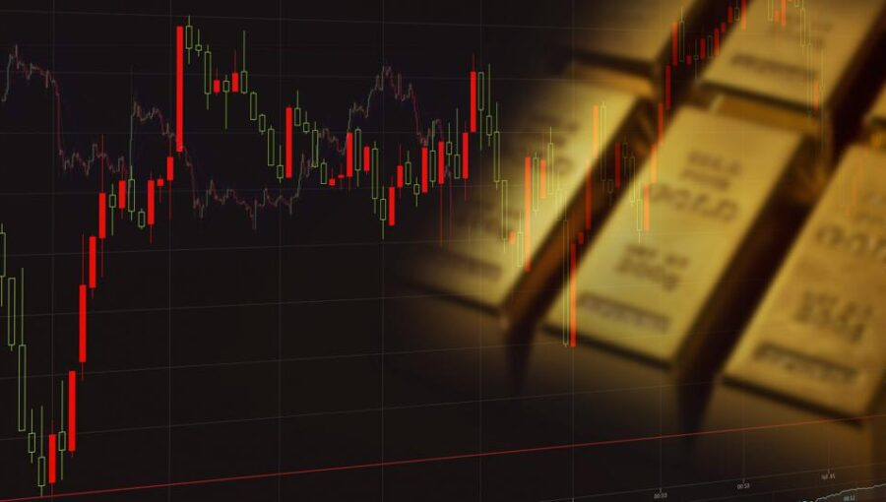
GOLD PRICE PREDICTION
A MACHINE LEARNING MODEL

Slide 2
PROBLEM STATEMENT
This project aims to leverage a comprehensive dataset of daily gold prices spanning from January 19, 2014, to January 22, 2024, obtained from Nasdaq. The dataset encompasses key financial metrics for each trading day, including the opening and closing prices, trading volume, as well as the highest and lowest prices recorded during the day.

Slide 3
DATASET DESCRIPTION
1. Date: A unique identifier for each trading day.
2. Close: Closing price of gold on the respective date.
3. Volume: Gold trading volume on the corresponding date.
4. Open: Opening price of gold on the respective date.
5. High: The highest recorded price of gold during the trading day.
6. Low: The lowest price recorded for gold in the trading day.

Slide 4
DATA VISUALIZATION
Data visualization is the representation of data through use of common graphics, such as charts and plots. Here, we have used “Matplotlib” and “Seaborn” for data visualization

Slide 5
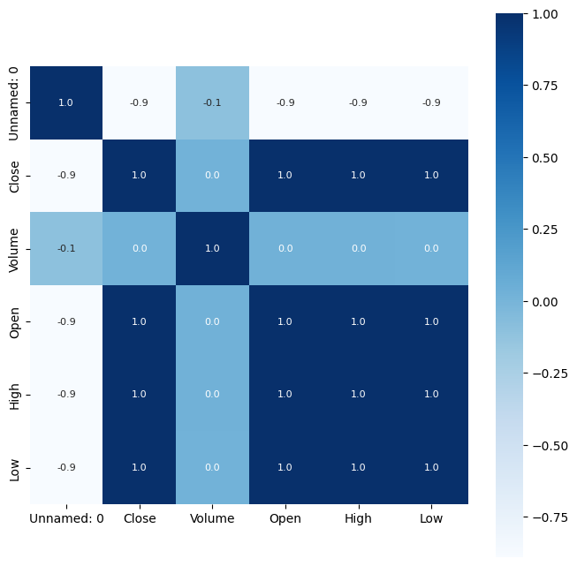
HEATMAP

Slide 6
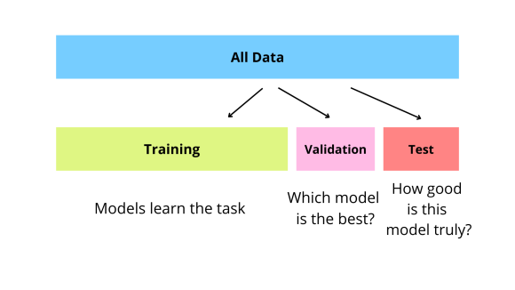
TRAIN TEST SPLIT

Slide 7
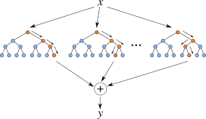
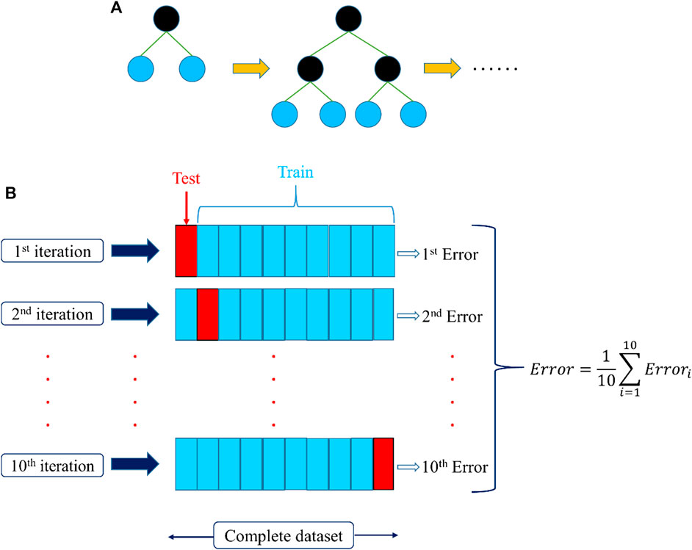
MODEL TRAINING
RANDOM FOREST REGRESSOR
XGBOOST REGRESSOR

Slide 8
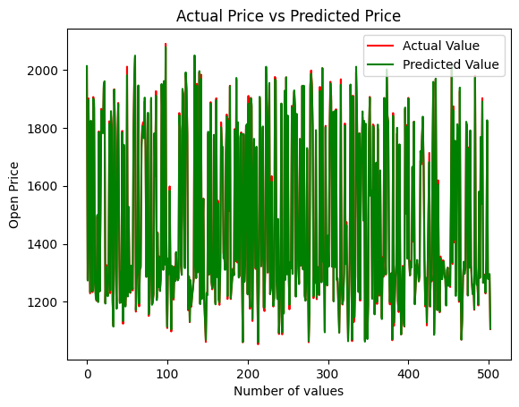
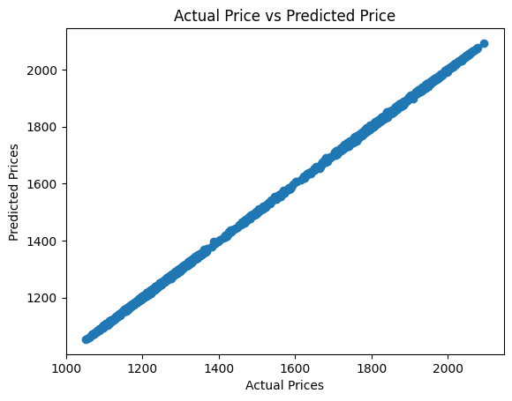
MODEL EVALUATION
RANDOM FOREST REGRESSOR
XGBOOST REGRESSOR

Slide 9


